Slide 1
A Promising Path to Success for System of Care Transformation
July 2021

Slide 2
PRESENTERS
Stacy Reh, Project Director, Promising Path to Success 1 & 2, New Jersey Children’s System of Care
Deja Amos, MSW, Operations Manager, Tri County Care Management Organization
Stephanie Suriani, LCSW,
Program Manager, Tri County Care Management Organization

Slide 3
New Jersey Children’s System of Care History
2006
The Department of Children and Families (DCF) becomes the first cabinet-level department exclusively dedicated to children and families [P.L. 2006, Chapter 47].
July 2012
Intellectual/developmental disability (I/DD) services for youth and young adults under age 21 is transitioned from the Dept. of Human Services (DHS) Division of DD to the DCF Children’s SOC (CSOC)
Oct 2019
NJ receives 2nd Consecutive SAMHSA Grant System of Care Expansion and Sustainability
July 2013
Substance use treatment services for youth under age 18 is transitioned from DHS, Division of Mental Health and Addiction Services, to DCF/CSOC.
1999
NJ wins a federal system of care (SOC) grant that allowed us to develop an SOC.
2000 - 2001
NJ restructures the funding system that serves children. Through Medicaid and the contracted system administrator, children no longer need to enter the child welfare system to receive behavioral health care services.
2007 – 2012
The number of youth in out-of-state behavioral health care goes from more than 300 to three.*
May 2013
Unification of care management, under CMO, is completed statewide.
December 2014
Integration of Physical and Behavioral Health is piloted in Bergen and Mercer County with expected Statewide rollout
July 2015
NJ wins a Federal SAMHSA Grant
System of Care -Expansion and Sustainability
*How did we do this? Careful individualized planning and the development of in-state options (based on research about what kids need) using resources that were previously going out of state.
Notes:
New Jersey’s Children's System of Care is a mature 20-year-old system that offers a wide range of statewide services for children up to age 21 with behavioral health, developmental disabilities or substance use needs. These services include community-based services, in-home services, out-of-home residential interventions, and family support services.

Slide 4
SOC VALUES AND PRINCIPLES
Youth-Guided and Family-Driven
Community Based
Culturally/Linguistically Competent Services
Strength Based
Unconditional Care
Promoting Independence
Family Involvement
Collaborative
Cost Effective
Comprehensive
Individualized
Home, School, and Community Based
Team Based
Notes:
Fewer children in institutional care: 37,000 youth currently being served in our SOC; 14,190 receiving CMO services
Fewer children accessing inpatient treatment: 852 youth with behavioral health needs receiving residential treatment; Less than 10% of youth with behavioral health needs receiving a residential intervention
Currently no children with behavioral health needs in an out-of-state facility
Closure of state child psychiatric hospital and state-run Residential Treatment Centers
Fewer youth in detention centers-Closed 10 centers

Slide 5
Residential Treatment is an Intervention, not a Destination

Slide 6
Promising Path to Success (PPS)
A statewide initiative that combines the evidenced-based model of 6 Core Strategies with the Nurtured Heart Approach® to build inner wealth in youth and families, while supporting system partners in creating safer, healing, trauma-informed environments
Notes:
-PPS is not just about OOH– the role of CMOs, FSOs, IICs, and system partners is important in this initiative. CMO/FSO helps to prepare youth and family for a residential intervention, what they can expect in treatment, particularly with this initiative, and ensuring those standards are being met.
-For youth to be successful when they go back home all partners need to be working together
-SAMHSA funded expansion grant for the Children’s System of Care
-September 30, 2015-September 30, 2019
-Statewide Implementation-5 Phases to the grant over the 4 years, all 21 counties

Slide 7
Promising Path To Success (PPS) VISIon
PPS GOALS
PPS focused efforts on the following Department of Children and Families/Children System Of Care strategic plan priorities: ensuring that contracted services meet the needs of children and families served; using evidence informed service models for out-of-home services; increasing the capacity of treatment programs to improve treatment outcomes; and increasing the capacity of Care Management Organization staff and the community to recognize and reduce the impact of trauma.
Reduce the percentage of youth that re-enter treatment after transitioning back to the community from an initial episode
Reduce the percentage of youth in the system of care that require multiple episodes of residential intervention
Reduce the average length of stay for youth engaged in residential treatment to 9 months or less
Reduce and eliminate restraint, seclusion and coercion
Analyze and understand the impact of each type of system involvement to aid in making resource allocation decisions

Slide 8
Six core Strategies AND The nurtured heart approach®
Six Core Strategies is an evidence-based model presented in a two-day training format that provides a practical and accessible framework to guide a change in trauma-informed culture within organizations.
NHA is a relational approach that provides a language and a lens to recognize the greatness in others in order to build their inner wealth.
Stand 1 - Absolutely No!
Stand 2 - Absolutely Yes!
Stand 3 - Absolutely Clear!
Notes:
We coupled the evidenced practice of Six Core Strategies, with the language and lens of the Nurtured Heart Approach
Stand 1-Absolutely No! – Refuse to energize negativity
Stand 2-Absolutely Yes! – Super-energize success through Active, Experiential, Proactive & Creative Recognitions
Stand 3-Absolutely Clear! – Set clear, consistent limits and consequences in an unenergized way…there is power in clarity and resets
Youth with intensity have learned that they get more connection from adults when things are going wrong (using their intensity in negative ways)
Create new Portfolios that are energetically aligned
Build Inner Wealth in youth
NHA asks us to alter our lens, create firsthand experiences of success, & make miracles out of molecules in any moment.
Provide the ability to reset
It must be genuine and provide evidence

Slide 9
Six Core Strategies
Leadership toward organizational change
The use of data to inform practice
Workforce development
Full inclusion of individuals and families
The use of self-regulation tools, which include the environment of care and use of sensory modulation
Rigorous debriefing after events in which seclusion and restraint might have been used
Notes:
This first strategy is considered core to creating healing environments of care through the consistent and continuous involvement of senior facility leadership. Leadership defines and articulates the mission, philosophy of care, guiding values, regularly communicates the importance of implementation and assures success.
To use data in an empirical, non-punitive, manner. Includes using data to analyze characteristics of facility usage by unit, shift day, and staff member; identifying facility baseline; setting improvement goals and comparatively monitoring use over time in all care areas, units and/or state system like facilities.
This is NOT just training. To create a healing environment in which policy, procedures, and practices are grounded in and directed by a thorough understanding of the neurological, biological, psychological and social effects of trauma and violence on humans and the prevalence of these experiences in persons who receive mental health services and the experiences of our staff.
To assure the full and formal inclusion of youth and families in organizational transformation through a variety of roles.
To create healing environments with a variety of tools and assessments that are integrated into each individual youth’s treatment. Includes the use of assessment tools to identify risk factors for violence and seclusion and restraint history; use of a trauma assessment; tools to identify persons with risk factors for death and injury; the use of de-escalation or safety surveys and contracts; and environmental changes to include comfort and sensory rooms and other meaningful clinical interventions that assist people in emotional self management.
To reduce the use of S/R and incidents through knowledge gained from a rigorous analysis of the event and the use of this knowledge to inform policy, procedures, and practices to avoid repeats in the future. A secondary goal of this intervention is to attempt to mitigate to the extent possible the adverse and potentially traumatizing effects of an incident for involved staff and youth and all witnesses to the event.
-It is imperative that senior clinical and medical staff, including the medical director, participate in these events.
-No Blame or Shame

Slide 10
key components for implementation and Sustainability
Pre-Kick Off Nurtured Heart Trainings
Local Kick Offs to Provide Overview of the Initiative
Six Core Strategies (6CS) for OOH Treatment Partners, Care Management, Family Support, Mobile Response, and Other Partners
Coaching for Residential Intervention Providers on 6CS Implementation
Nurtured Heart Approach® (NHA) Super User Group
State Policy, Contract, and Procedure Changes
Notes:
1-Provided the common language and lens
2-Provided a thorough overview of the grant, its goals and expectations
3- 2 day training at the start of each of the 5 phases
4-Each site, received a coach that started work with them prior to kick off, through training and for 9-11 months to support identification of areas of improvement, implementation of 6CS and NHA
5- SuperUser Meetings started out quarterly but have become monthly events and provide a space for sharing NHA training, embedding and engaging ideas…keep the NHA spark alive and well!
6- State including language and PPS principles in RFPs, contracts and its engagement activities…influenced other initiatives

Slide 11
Implementation of Promising Path to Success: Tri County Cmo’S (TCCMo) Organizational Perspective
Notes:
Stephanie

Slide 12
the nha® core methodology: The 3 stands™
Stand 1:
ABSOLUTELY NO!
I refuse to give my time, energy, and relationship to negative behavior. I will not accidentally foster failure nor will I reward problems by responding to them in animated ways. I will save my time and energy for searching for success.
Stand 2:
ABSOLUTELY YES!
I will relentlessly and strategically pull people into new patterns of success. I will constantly recognize the success and achievement that employees are displaying no matter how small and present them with clear undeniable evidence of their value and how great they are.
Stand 3:
ABSOLUTELY CLEAR!
I will have clear and consistent consequences for employees when a rule has been broken. “Here are the standards
/expectations, and here’s what happens when you don’t meet them”.
Utilizing Recognitions and Resets at every level of the agency and weaving it into how we operate as well as helping staff with their own self-regulation through the concept of reset
Notes:
Stephanie

Slide 13
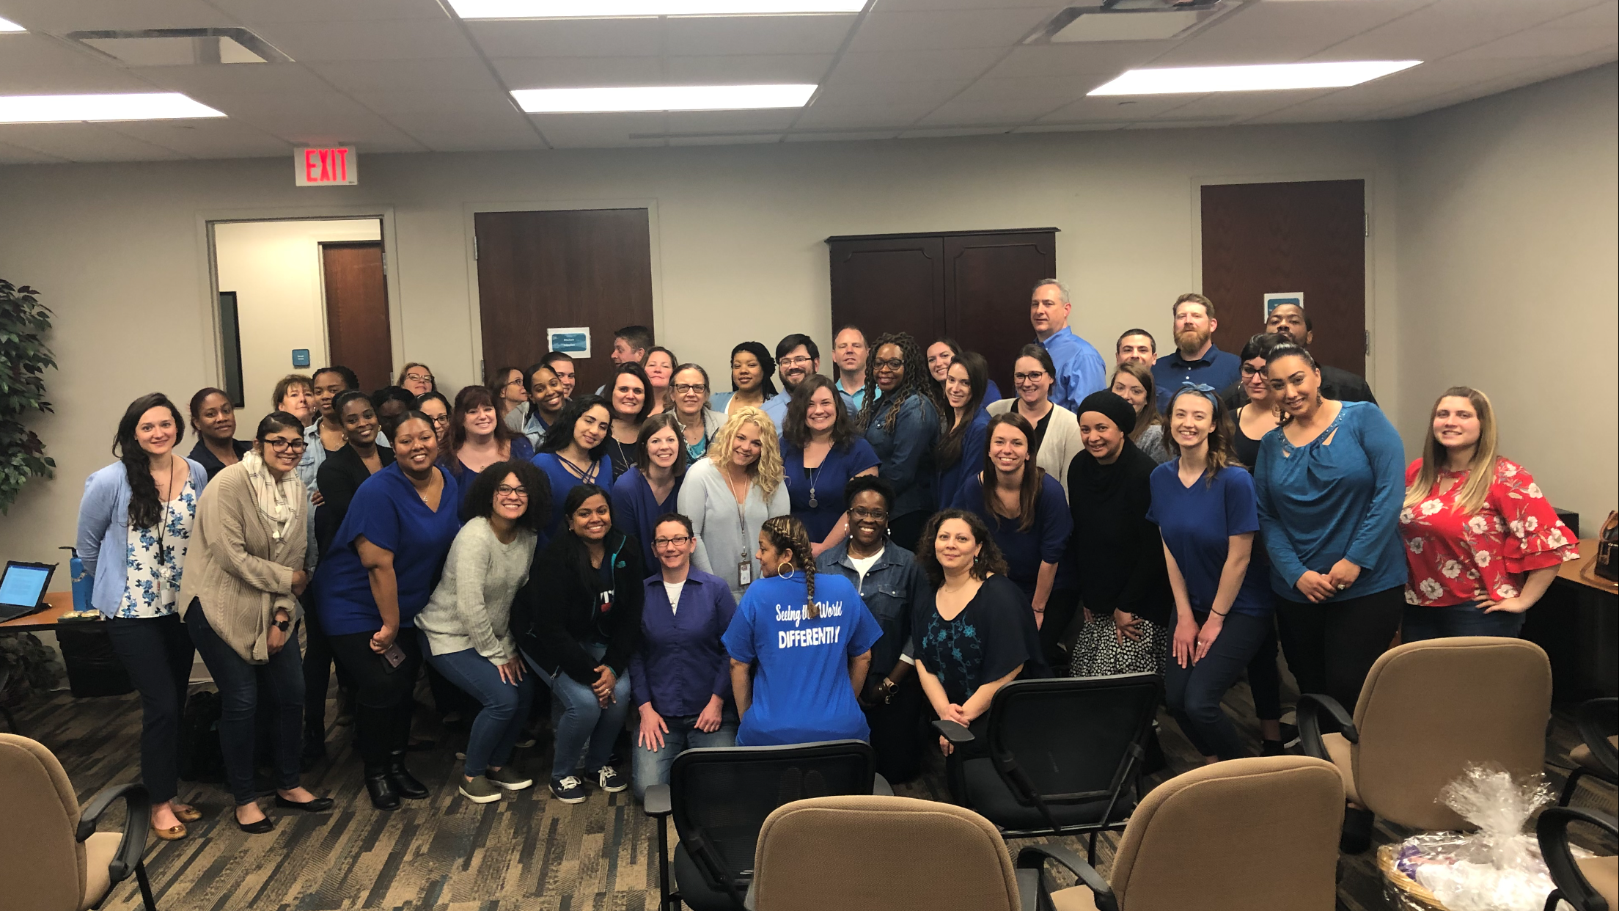
Perspectives on Creating a Culture Change
Notes:
Stephanie

Slide 14
Care Manager
Notes:
Stephanie

Slide 15
Lead care manager

Slide 16
Scope of Staff involvement and Agency Resources
Initial Planning to Integrate NHA® and 6 Core Strategies in TCCMO:
Buy-in at the management level, had 4 NHA® certified trainers (now have 7)
Formed 4 workgroups (policies and procedures, OOH, work with families, physical workspace). 6-8 staff per committee from every level to address each of the 6 Core Strategies related to agency practices and values
All staff trained in Nurtured Heart Approach® (NHA) (6 hours)
Cost – Minimal monetary cost associated with sensory objects, creating WOW wall and “Our Why Tree” and additional funds to be spent on wall art
Notes:
Stephanie

Slide 17
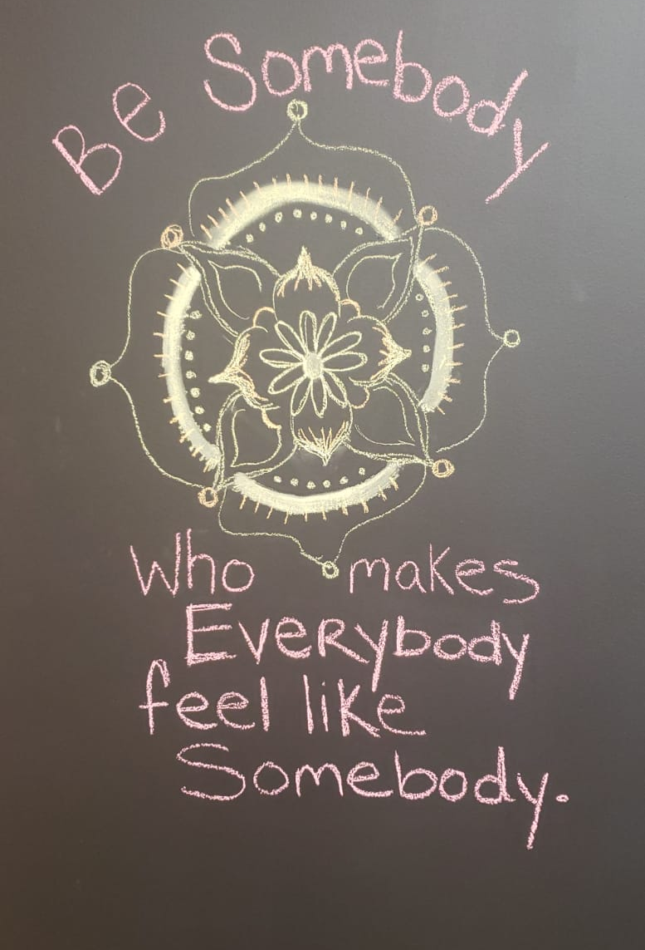
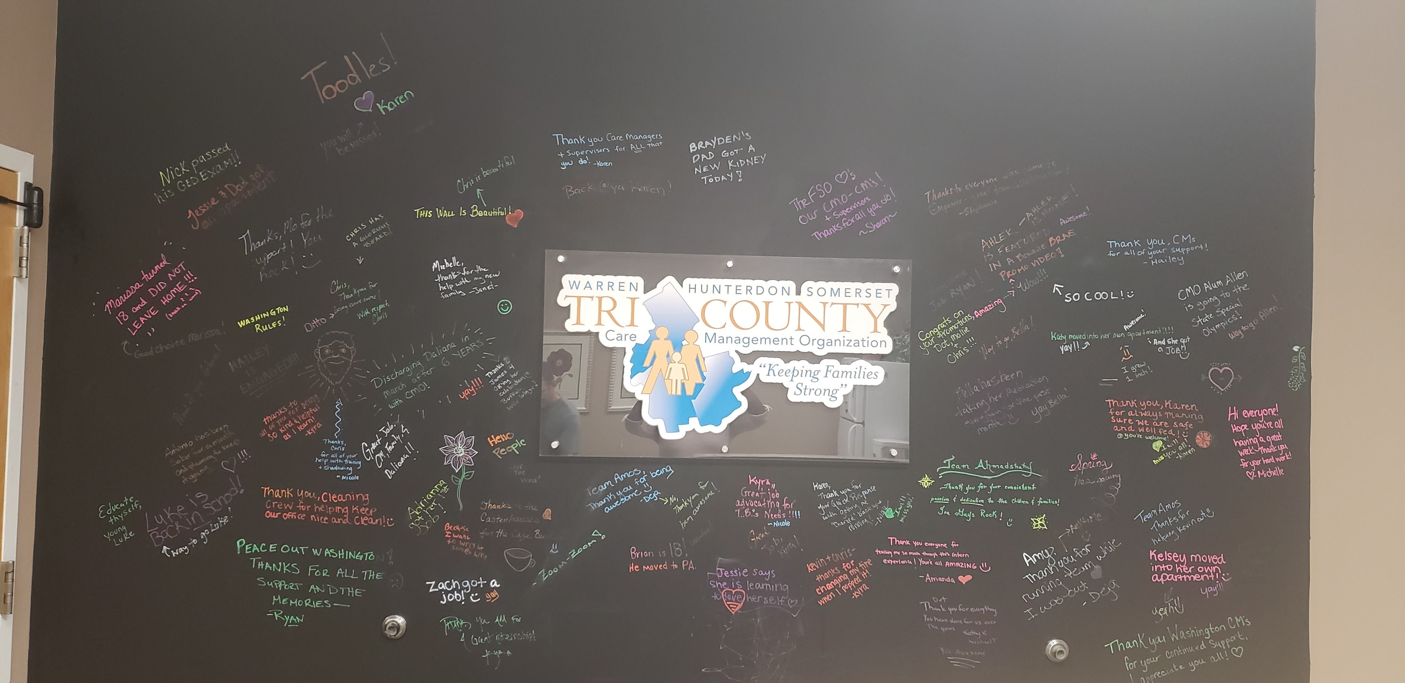
Infusing NHA® Into Our Physical Space
Notes:
Deja – discussed sensory room and cart

Slide 18
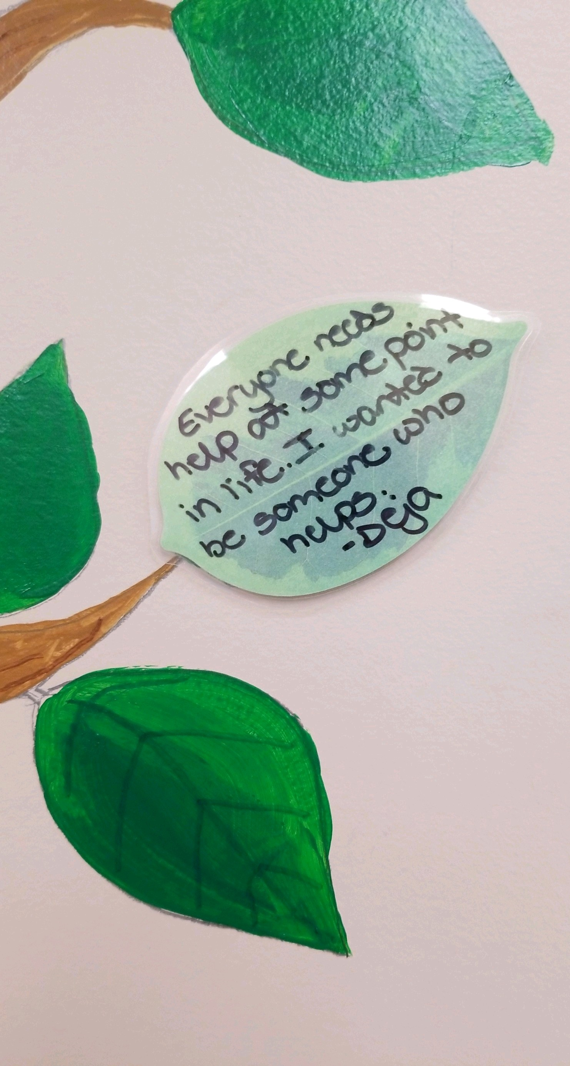
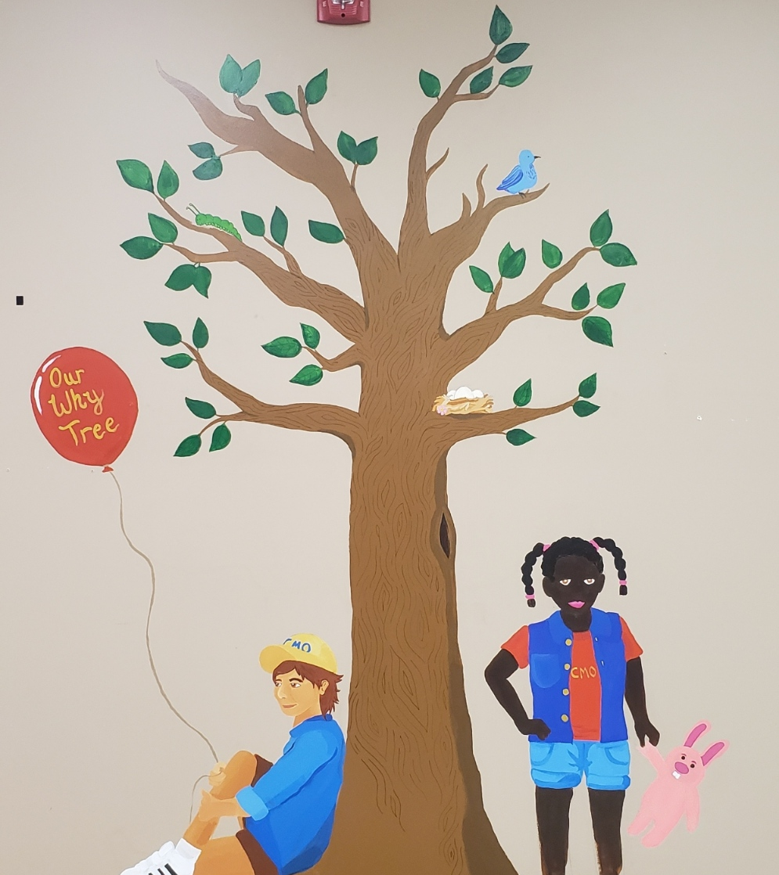
Our Why Tree
What’s Your Why?
Notes:
Deja

Slide 19
Staff Support AND Self-Care
Committee thinking about how we celebrate staff strengths – currently on WOW walls (physical and electronic) – Absolutely Yes!
Positive mindset screensaver link and affirmations distributed to staff
Honoring staff emotional well-being
Implementing a debriefing after staff experience a crisis with one of their families
Weekly mental health check in
Virtual reset room
Notes:
Deja

Slide 20
Infusing NHA® Into Our virtual Space
Notes:
Deja

Slide 21
Supporting Staff’s Emotional Well-being
5-minute meditation exercise to start meetings
Meaningful quotes exercise
Caucus discussions on racism
Wellness Channel on Teams
Virtual team building activities – Escape Room (agency funds quarterly activities)
Notes:
Deja

Slide 22
Supervision and Evaluation
Revamping performance evaluations that highlight strengths and include self assessment
Reviewing supervision agenda to be more NHA-friendly and focusing on strengths of supervisees, their agenda first, checking in on their stress level
Recognizing positive achievements of supervisees with more specificity
Notes:
Stephanie

Slide 23
“People will forget what you said, people will forget what you did, but people will never forget how you made them feel.” Maya Angelou
Notes:
Stephanie

Slide 24
Care Manager Supervisor
Notes:
Stephanie

Slide 25
Recognitions of work with our families via Email
Kristen – I know this must’ve been tough to transition your last youth on your youthload. Thank you for all that you did for Sara! You stood by her through all the ups and downs and ensured she transitioned to appropriate long-term adult services. You remained positive and advocated to no end! We are so lucky to have such a caring and compassionate care manager (now specialist) represent our youth and families 😊
Kevin – Thank you for your consistent follow through with this family. There was so much going on and you not only maintained ongoing communication, but you were persistent and professional with both parents and helped streamline information and remain neutral. Thank you for your dedication and commitment 😊
Notes:
Stephanie

Slide 26
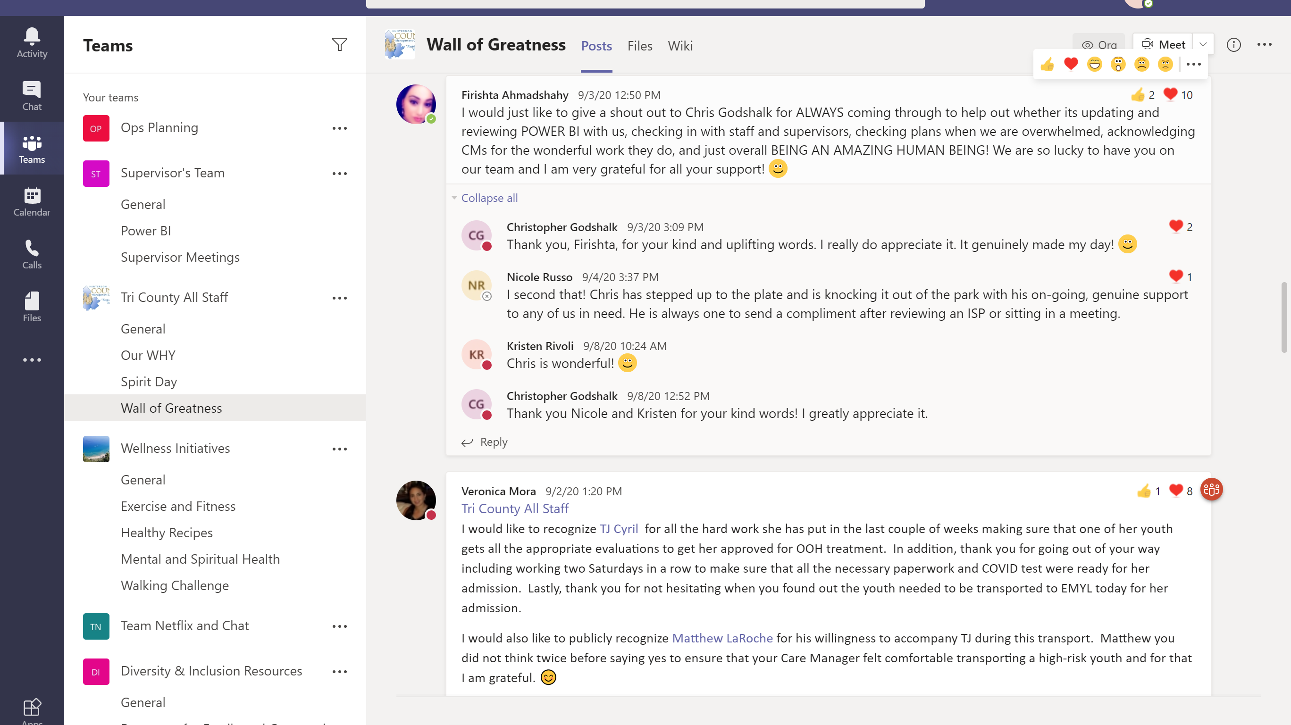
Notes:
Stephanie

Slide 27
Policies, Procedures and Hiring Practices
Formed a committee to look at every area of an employee’s tenure at the CMO and ensure that our processes/practices are aligned with the principles of the Nurtured Heart Approach
“Communicating with kindness and relating to people on a heart-level to grow their greatness”
Implemented a referral program for staff that refer candidates who become hired
Revamped onboarding process and created structured two-day orientation that includes a team-building lunch
Reviewing exit interviews and staff satisfaction surveys to ensure NHA® practices, and revamping job descriptions
Implemented physical and virtual suggestion boxes monitored by care management staff to bring positive change to all staff
Management implemented virtual Town Hall meetings to process questions and information after large staff meetings and gatherings, and to stay connected in our relationships
Notes:
Deja

Slide 28
Policies, Procedures and Hiring Practices, CONT.
Staff Celebrations Meetings
Integrated Nurtured Heart® activities into regular meetings (team and supervisor meetings – identifying greatness)
Thankfulness team activities
Cultural share potluck
Staff satisfaction survey
Success Stories highlighted in agency newsletter
NHA-style “Recognitions” giving specific positive feedback to staff on their anniversaries with the agency
Notes:
Deja

Slide 29
S: What I see / sense
A: What I appreciate about that
R: What that reveals to me
A: You are / I am
H: Heart
Notes:
Stephanie

Slide 30
Anniversary Recognitions
Current
I see that KA is ALWAYS willing to help out members of his teams. And instead of taking credit, he acknowledges them for allowing him to come out to meetings and teaching him how to do things. Also, no matter how busy he is, I see that K starts a conversation by asking “how are you”, “how was your weekend” and really demonstrating that he cares about you as a person. I see him sharing parts of himself and funny stories of his daughter or his family or sharing a funny show or movie he has watched. I appreciate that K is helpful and also personable, and just a general pleasure to work with. That reveals to me that he values being part of a team, and not just working together but knowing people on a personal level. K you are the greatness of HELPFULNESS WITH HUMANITY. I mean this from the HEART.
Previous
Congratulations to KA on the anniversary of his first year with Tri County CMO. Thank you, K, for all you have done on behalf of the agency for the families in Somerset, Hunterdon and Warren County.
Notes:
Deja – highlight S.A.R.A.H. structure

Slide 31
Mutual Accountability with System Partners and Out of Home (ooh) programs
Created a NHA fact sheet for OOH programs highlighting our youth’s strengths and sending them to programs utilizing the approaches
Looking at youth who are in OOH for a long time and how connected they are to community/family
Working with OOH providers to co-train parents of youth in OOH or are at risk of going to OOH
Meetings with OOH providers in our area to collaborate on integration of NHA and 6CS, and inviting other CMOs to those meetings – Building Relationships
Took the NHA training to local Division of Child Protection & Permanency (DCP&P) offices
Collaboration with other system partners in training NHA to other providers, parents, and youth
Quarterly planning/idea sharing meetings involving NHA certified trainers in the Tri County area, including OOH providers, Mobile Response and Stabilization (MRSS), Family Support Organization (FSO), and Care Management Organizations (CMO)
Notes:
Stephanie

Slide 32
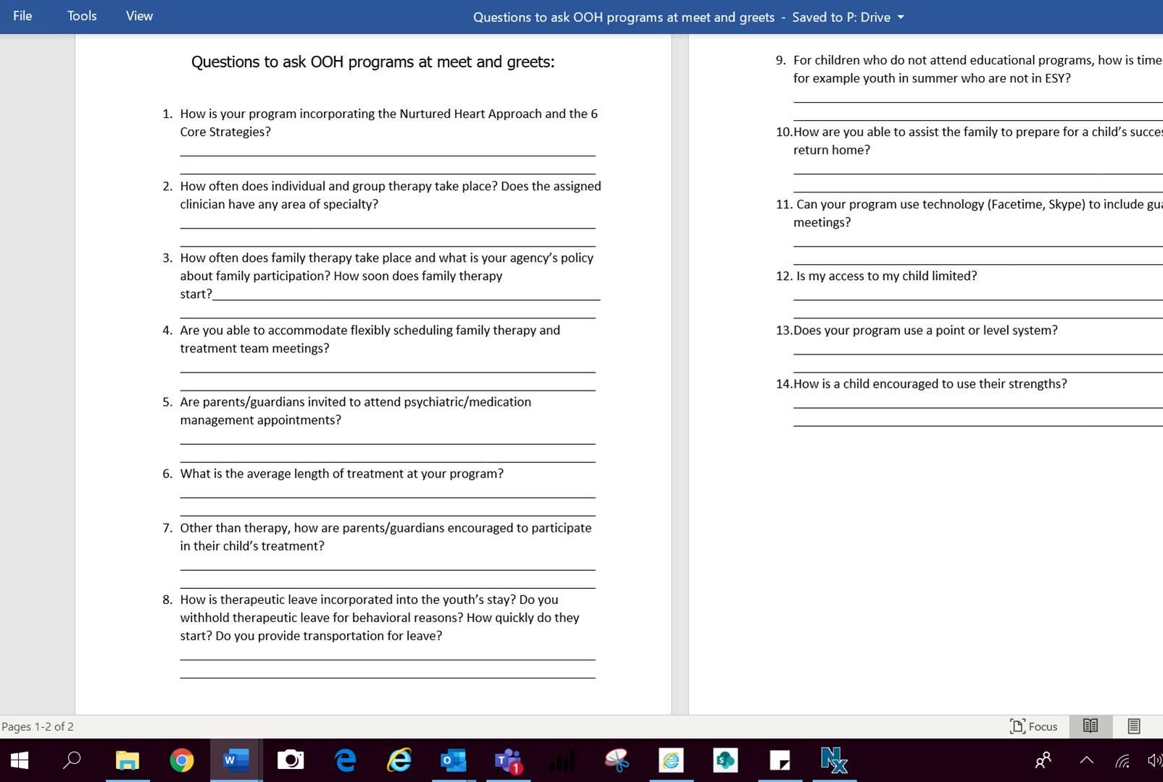
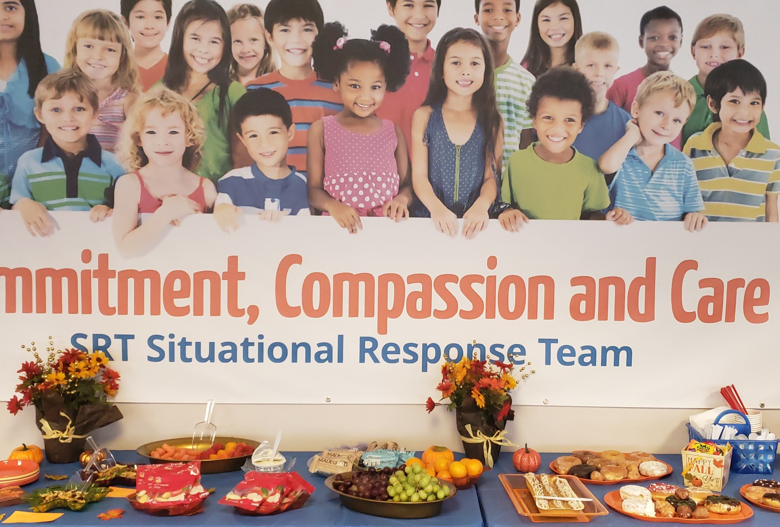
Notes:
Stephanie

Slide 33
Outcomes and Successes
Positive cultural shift among staff – Implementation of strengths-based approaches and resulted in staff previously struggling to be promoted
New employee feedback with integration of 6CS/NHA into personnel practices/orientation
Best first week ever!”
Positive feedback from parents regarding attendance at training
“It gave me tools to help my child with his behaviors and made me feel that I’m not alone in dealing with him.”
“The Nurtured Heart Approach isn’t just about positive reinforcement. It’s a practice that touches on every interaction and the opportunity each offers for building relationships, self-esteem and success.”
Notes:
Deja

Slide 34
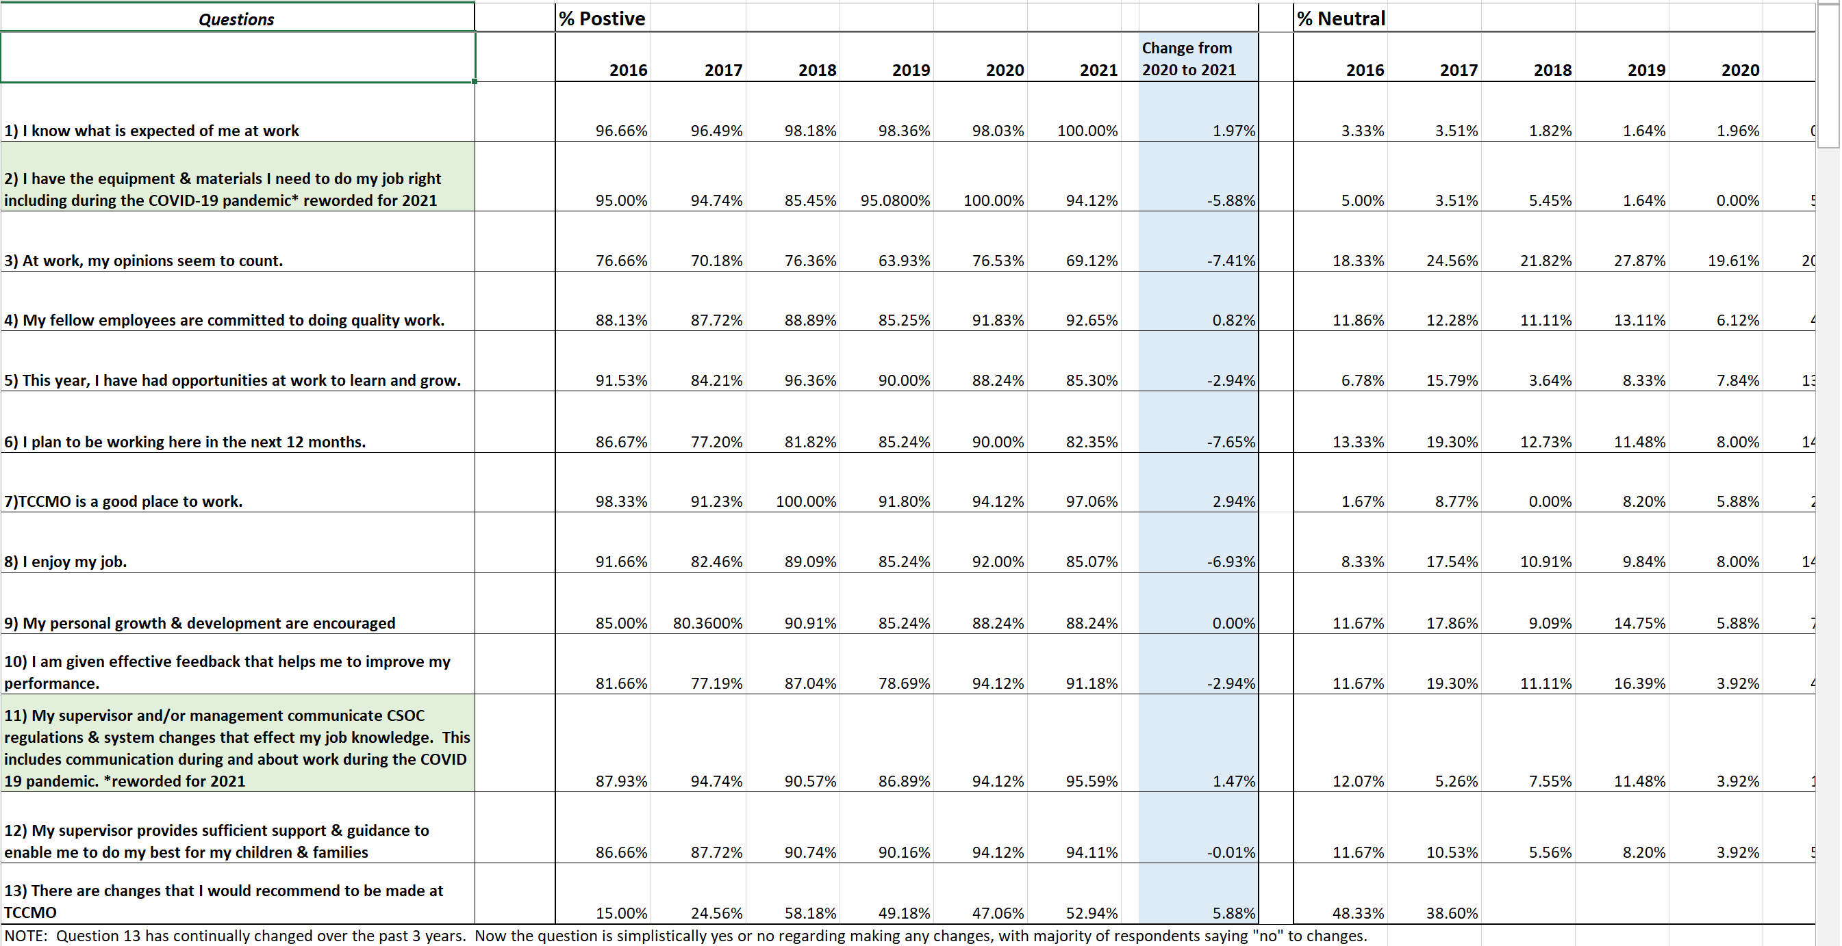
Notes:
Deja

Slide 35
Return on Investment
Goals
Reduce the percentage of youth that re-enter treatment after transitioning back to the community from an initial treatment episode
Reduce the percentage of youth in the SOC that require multiple episodes of residential intervention
Reduce the average length of stay for youth engaged in residential treatment to 9 months or less
Reduce and eliminate restraint, seclusion and coercion
Analyze and understand the impact of each type of system involvement to aid in making resource allocation decisions
Results
Significant improvement in CANS domains in youth life functioning, child strengths, child behavioral and emotional needs
The number of youth in OOH treatment decreased during the grant period by approximately 33%
The average length of stay for youth in OOH treatment decreased from 358 days to 256 days, a reduction of 28%.
Preliminary findings suggest a significant reduction in the number of restraints across programs implementing PPS, averaging approximately 24 averted restraints per program (based on comparison group restraint incidence adjusted for size) in the 12 months following implementation.
Notes:
With support and data from Medicaid, Education, Residential Intervention providers, Juvenile Justice, Child Welfare and other system partners, we are looking to measure the impact of both the Promising Path to Success grant as well as the Children’s System of Care as a whole.

Slide 36
What Is next
Feedback and recommendations yielded a second SAMHSA Expansion Grant – Promising Path to Success 2.0 (PPS2)
Focus of PPS2:
Six Core Strategies, NHA® and other evidenced based practices with Care Management Organizations, Family Support Organizations, Mobile Response Stabilization Services, Office of Education and Out of Home Schools​
NHA training for all child protection staff and all resource/kinship families​
Support leadership development of youth and families in participation and voice in County Based Children’s Inter-Agency Coordinating Council.

Slide 37
Contact information
Stacy Reh Stacy.Reh@dcf.nj.gov
Deja Amos damos@tricountycmo.org
Stephanie Suriani ssuriani@tricountycmo.org

Slide 38
QUESTIONS

